Slide 1

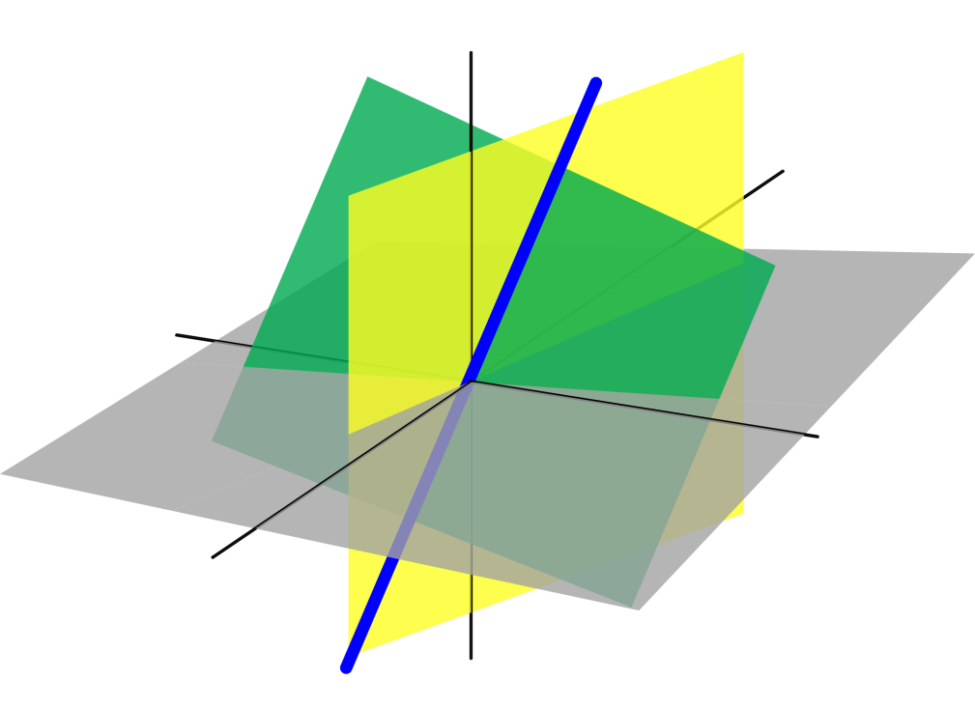
Azərbaycan Dövlət Neft və Sənaye Universiteti
Analytical Geometry

Slide 2
The Cross Product of Two Vectors in Space

Slide 3
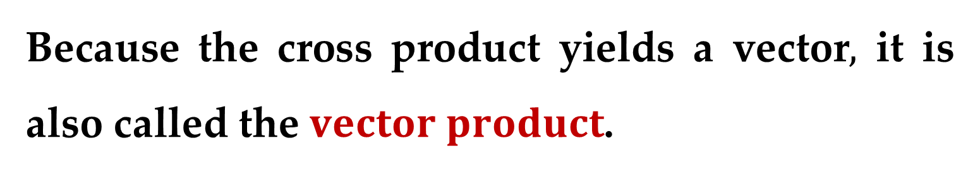
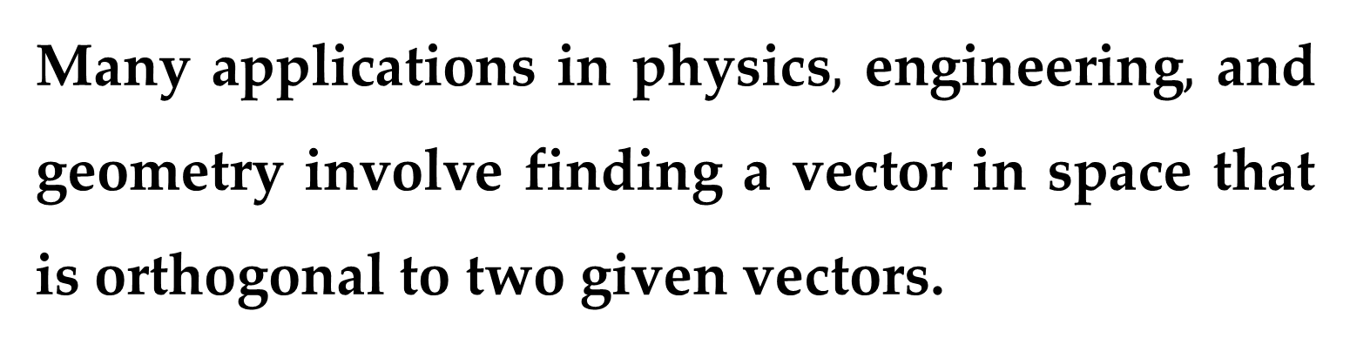
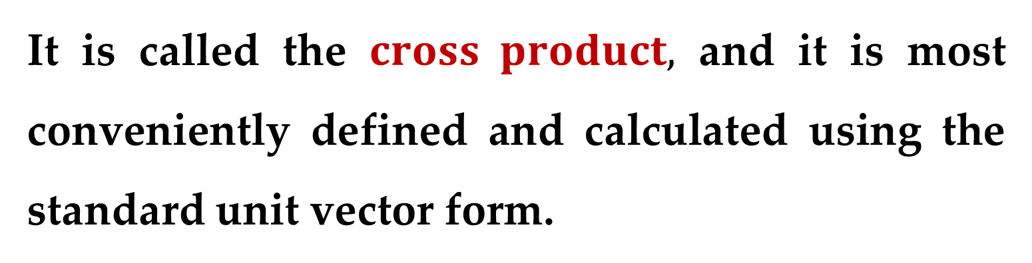
Many applications in physics$,$ engineering$,$ and geometry involve finding a vector in space that is orthogonal to two given vectors.
It is called the $cross product,$ and it is most conveniently defined and calculated using the standard unit vector form.
Because the cross product yields a vector$,$ it is also called the $vector product$.

Slide 4
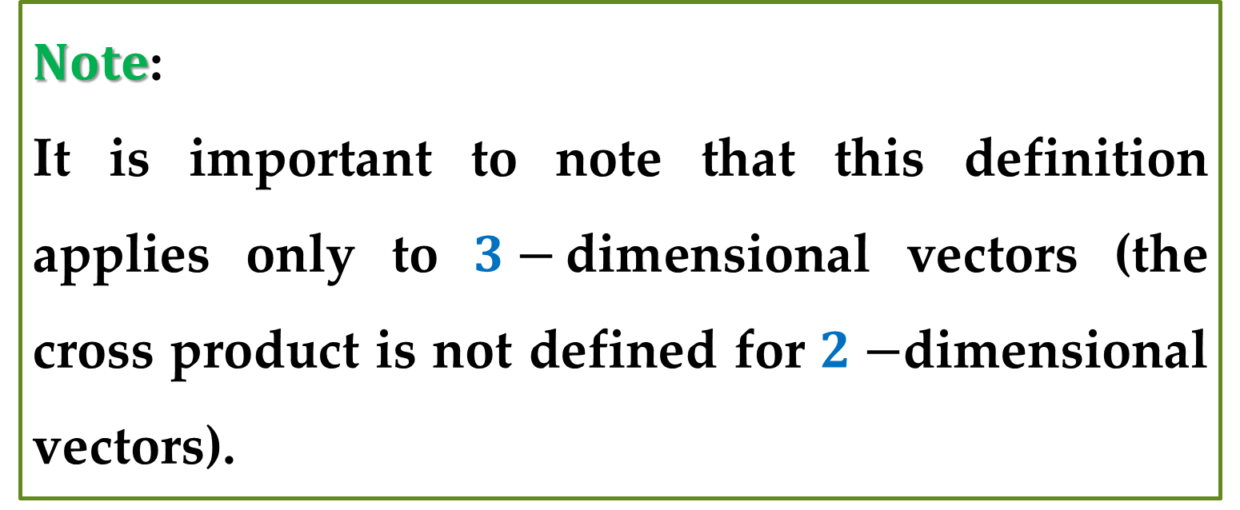
$Note$:
It is important to note that this definition applies only to $3−$dimensional vectors (the cross product is not defined for $2−$dimensional vectors).

Slide 5
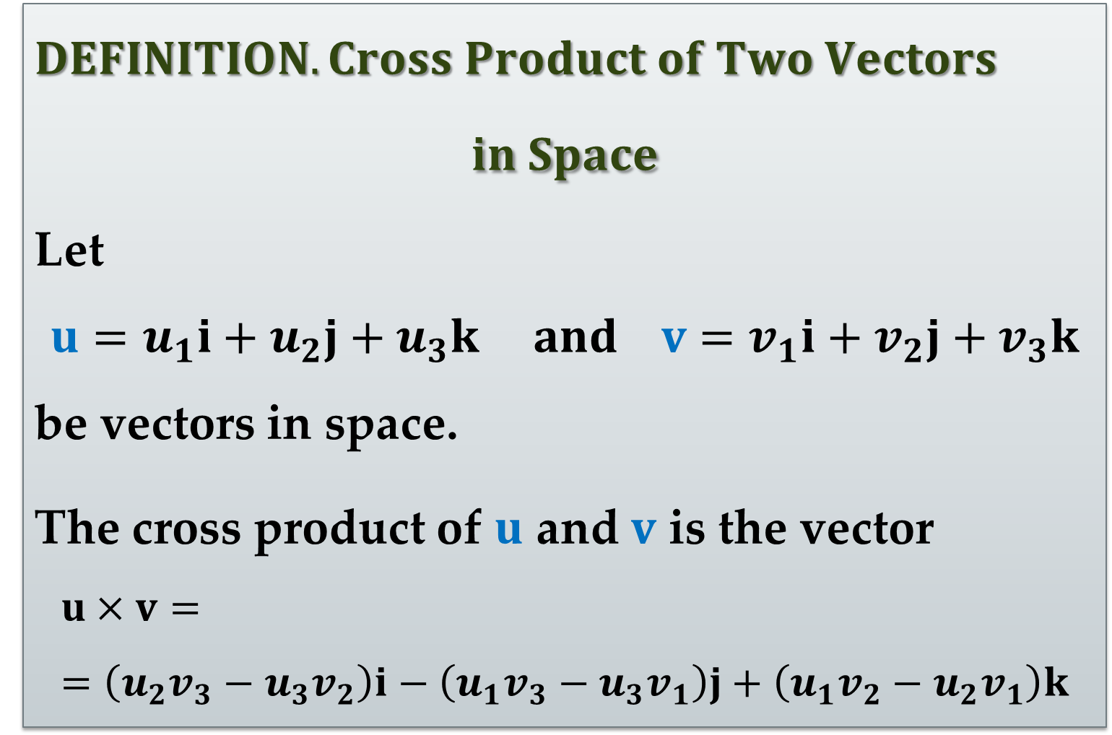
$DEFINITION. Cross Product of Two Vectors$
$$in Space$$
Let
$$u=u_{1}i+u_{2}j+u_{3}k and v=v_{1}i+v_{2}j+v_{3}k$$
be vectors in space.
The cross product of $u$ and $v$ is the vector
$$u×v==\left(u_{2}v_{3}−u_{3}v_{2}\right)i−\left(u_{1}v_{3}−u_{3}v_{1}\right)j+\left(u_{1}v_{2}−u_{2}v_{1}\right)k$$

Slide 6
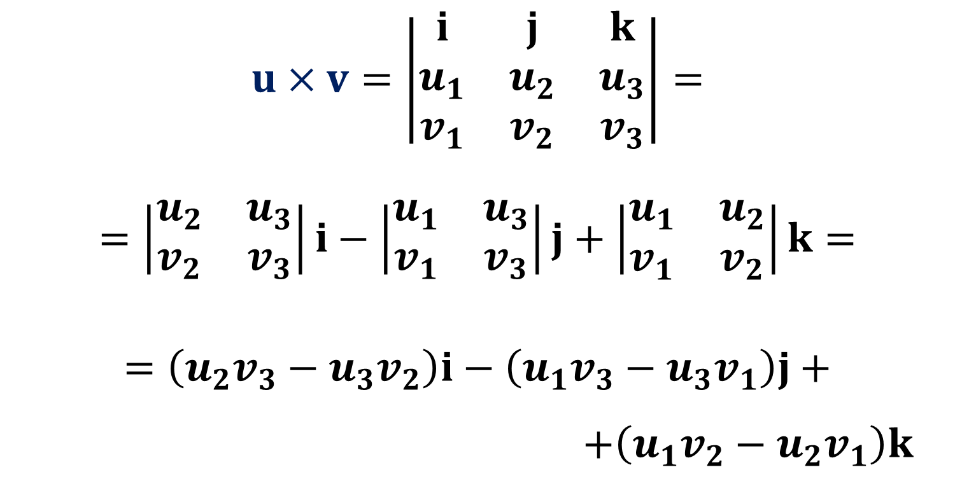
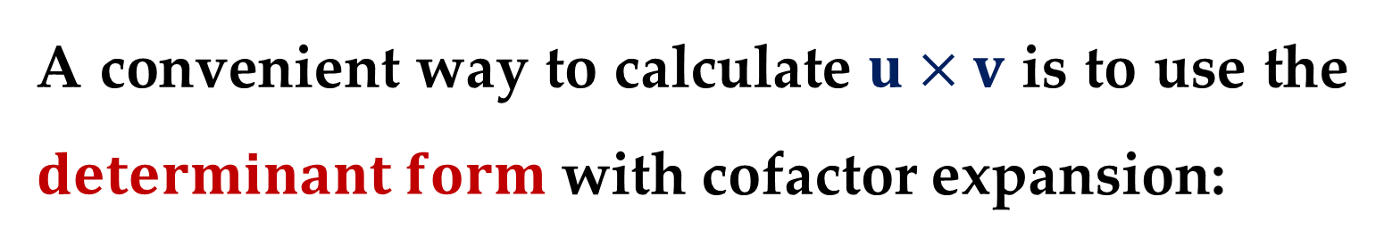
A convenient way to calculate $u×v$ is to use the $determinant form$ with cofactor expansion:
$$u×v=\left|\begin{matrix}i & j & k \\ u_{1} & u_{2} & u_{3} \\ v_{1} & v_{2} & v_{3}\end{matrix}\right|=$$
$$=\left|\begin{matrix}u_{2} & u_{3} \\ v_{2} & v_{3}\end{matrix}\right|i−\left|\begin{matrix}u_{1} & u_{3} \\ v_{1} & v_{3}\end{matrix}\right|j+\left|\begin{matrix}u_{1} & u_{2} \\ v_{1} & v_{2}\end{matrix}\right|k=$$
$$=\left(u_{2}v_{3}−u_{3}v_{2}\right)i−\left(u_{1}v_{3}−u_{3}v_{1}\right)j+$$
$+\left(u_{1}v_{2}−u_{2}v_{1}\right)k$

Slide 7
This determinant form is used simply to help remember the formula for the cross product —
it is technically not a determinant because not all the entries of the corresponding matrix are real numbers.
The first row of the determinant consists of three-dimensional vectors, while the remaining two rows consist of scalars.

Slide 8
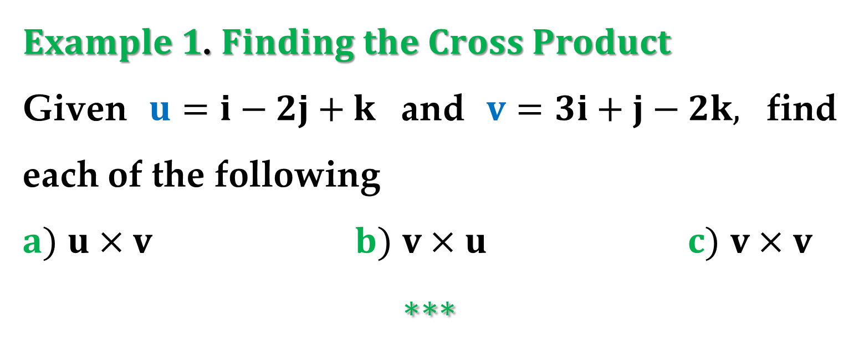
$Example 1$. $Finding the Cross Product$
Given $u=i−2j+k$ and $v=3i+j−2k,$ find each of the following
$a)$ $u×v$ $b)$ $v×u$ $c)$ $v×v$
$$∗∗∗$$

Slide 9
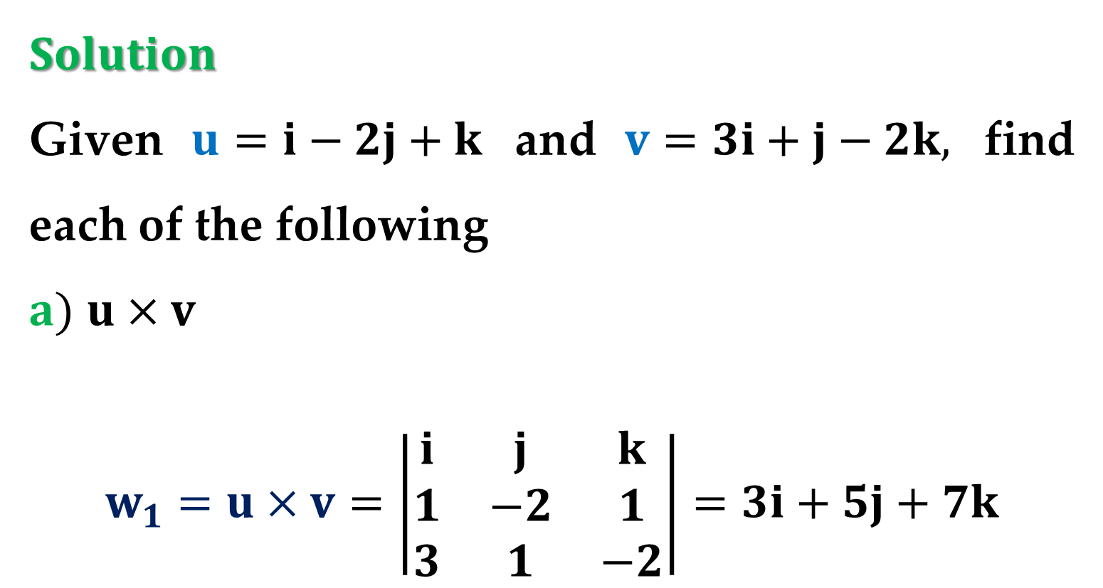
$Solution$
Given $u=i−2j+k$ and $v=3i+j−2k,$ find each of the following
$a)$ $u×v$
$$w_{1}=u×v=\left|\begin{matrix}i & j & k \\ 1 & −2 & 1 \\ 3 & 1 & −2\end{matrix}\right|=3i+5j+7k$$

Slide 10
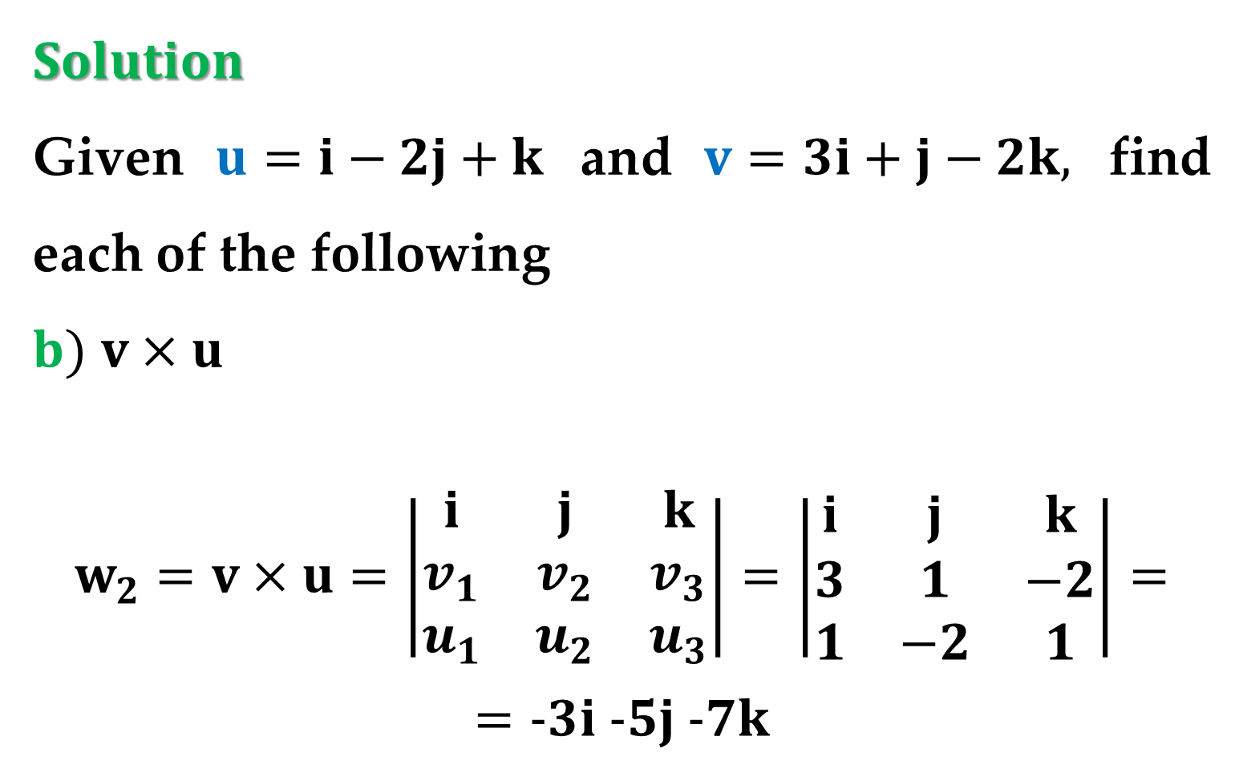
$Solution$
Given $u=i−2j+k$ and $v=3i+j−2k,$ find each of the following
$b)$ $v×u$
$$w_{2}=v×u=\left|\begin{matrix}i & j & k \\ v_{1} & v_{2} & v_{3} \\ u_{1} & u_{2} & u_{3}\end{matrix}\right|=\left|\begin{matrix}i & j & k \\ 3 & 1 & −2 \\ 1 & −2 & 1\end{matrix}\right|=$$
$$=−3i −5j −7k$$

Slide 11
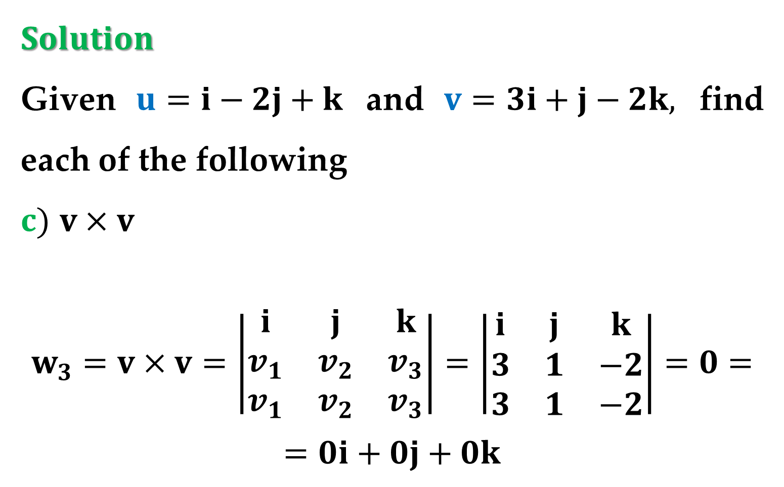
$Solution$
Given $u=i−2j+k$ and $v=3i+j−2k,$ find each of the following
$c)$ $v×v$
$$w_{3}=v×v=\left|\begin{matrix}i & j & k \\ v_{1} & v_{2} & v_{3} \\ v_{1} & v_{2} & v_{3}\end{matrix}\right|=\left|\begin{matrix}i & j & k \\ 3 & 1 & −2 \\ 3 & 1 & −2\end{matrix}\right|=0=$$
$$=0i+0j+0k$$

Slide 12
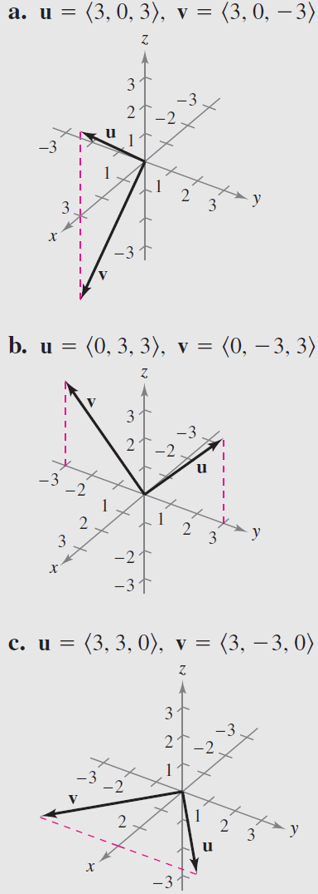
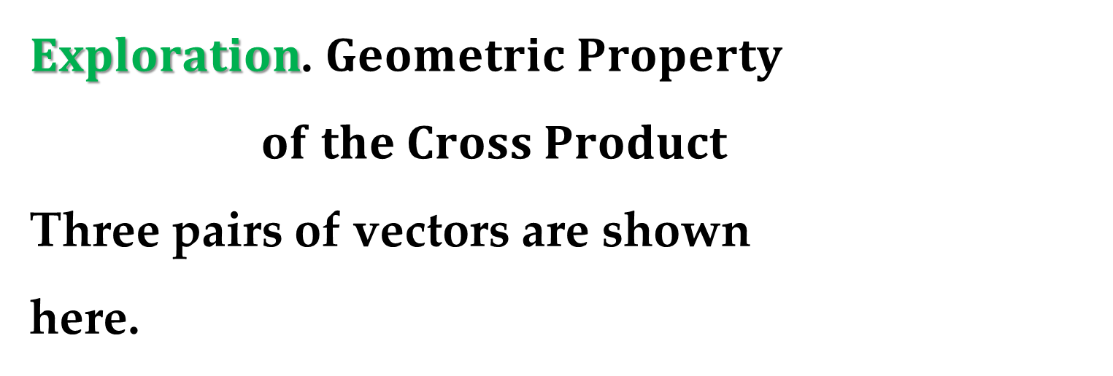
$Exploration$. $Geometric Property$
$of the Cross Product$
Three pairs of vectors are shown
here.
Use the definition to find the cross product of each pair.
Sketch all three vectors in a three-dimensional system.

Slide 13
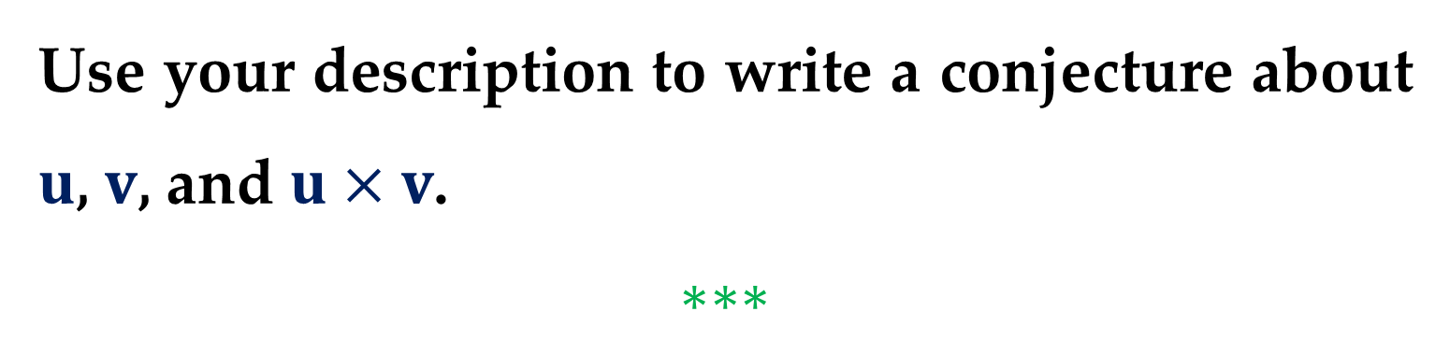
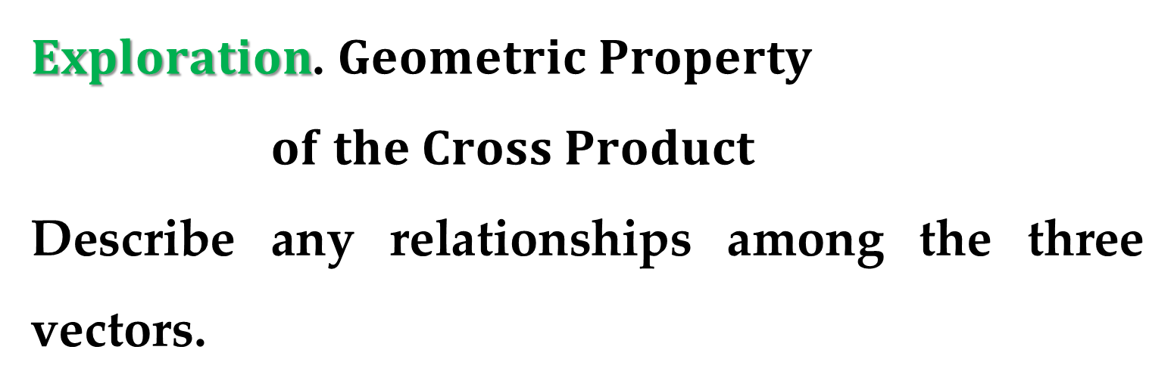
$Exploration$. $Geometric Property$
$of the Cross Product$
Describe any relationships among the three vectors.
Use your description to write a conjecture about $u$, $v$, and $u×v$.
$$∗∗∗$$

Slide 14
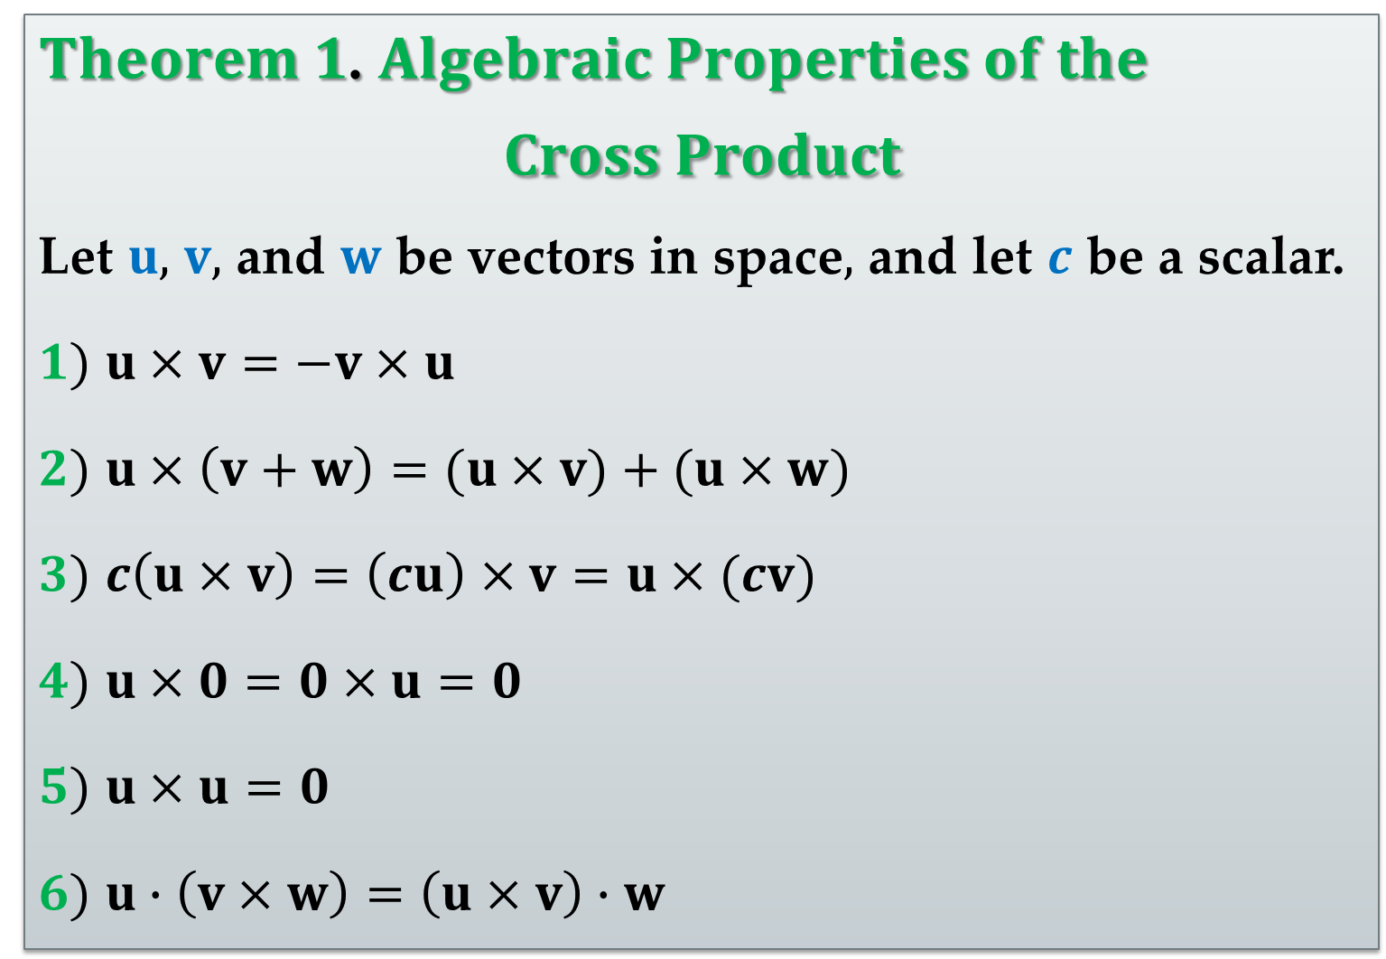
$Theorem 1$. $Algebraic Properties of the$
$$Cross Product$$
Let $u,$ $v,$ and $w$ be vectors in space$,$ and let $c$ be a scalar.
$1)$ $u×v=−v×u$
$2)$ $u×\left(v+w\right)=(u×v)+(u×w)$
$3)$ $c\left(u×v\right)=\left(cu\right)×v=u×(cv)$
$4)$ $u×0=0×u=0$
$5)$ $u×u=0$
$6)$ $u∙\left(v×w\right)=\left(u×v\right)∙w$

Slide 15
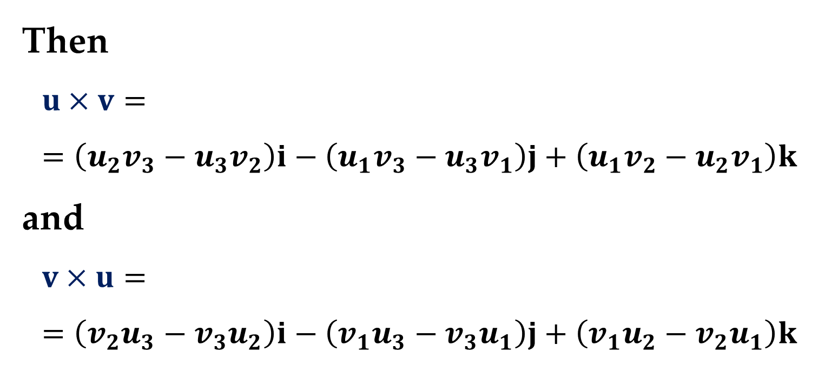
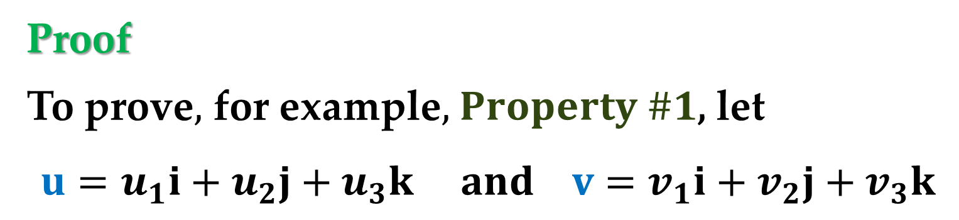
Proof
To prove$,$ for example$,$ $Property \#1$, let
$$u=u_{1}i+u_{2}j+u_{3}k and v=v_{1}i+v_{2}j+v_{3}k$$
Then
$$u×v==\left(u_{2}v_{3}−u_{3}v_{2}\right)i−\left(u_{1}v_{3}−u_{3}v_{1}\right)j+\left(u_{1}v_{2}−u_{2}v_{1}\right)k$$
and
$$v×u==\left(v_{2}u_{3}−v_{3}u_{2}\right)i−\left(v_{1}u_{3}−v_{3}u_{1}\right)j+\left(v_{1}u_{2}−v_{2}u_{1}\right)k$$

Slide 16
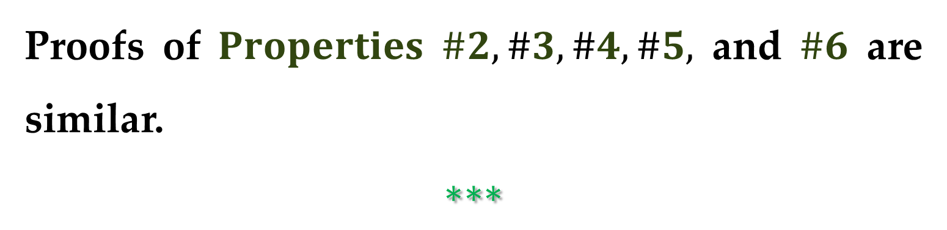

Proof (continued)
This implies that
$$u×v=−v×u$$
Proofs of $Properties$ $\#2, \#3, \#4, \#5,$ and $\#6$ are similar.
$$∗∗∗$$

Slide 17
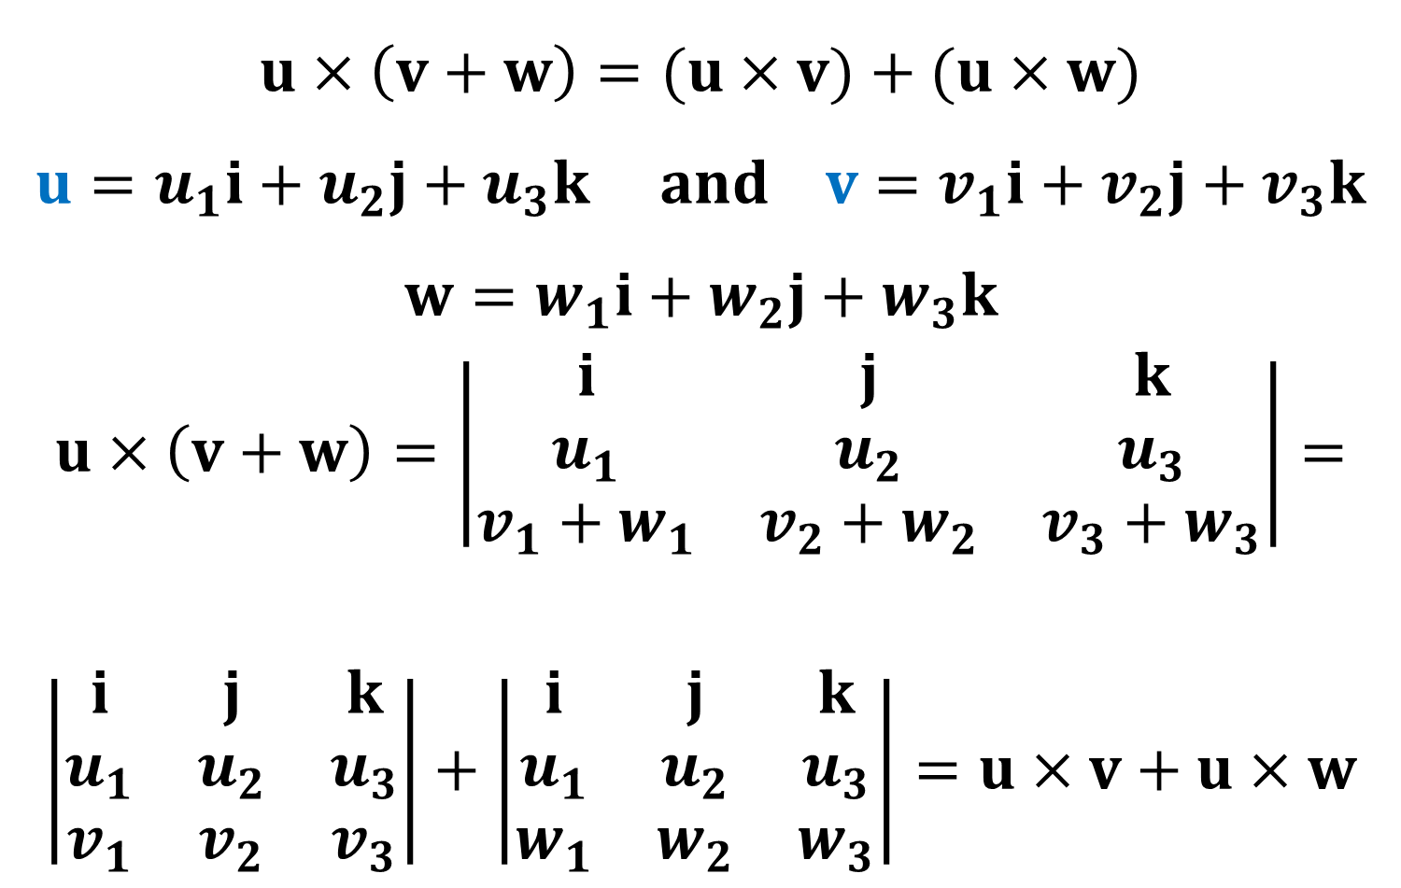
Proof (continued)
$$u×\left(v+w\right)=(u×v)+(u×w)$$
$$u=u_{1}i+u_{2}j+u_{3}k and v=v_{1}i+v_{2}j+v_{3}k$$
$$w=w_{1}i+w_{2}j+w_{3}k$$
$$u×\left(v+w\right)=\left|\begin{matrix}i & j & k \\ u_{1} & u_{2} & u_{3} \\ v_{1}+w_{1} & v_{2}+w_{2} & v_{3}+w_{3}\end{matrix}\right|=$$
$$\left|\begin{matrix}i & j & k \\ u_{1} & u_{2} & u_{3} \\ v_{1} & v_{2} & v_{3}\end{matrix}\right|+\left|\begin{matrix}i & j & k \\ u_{1} & u_{2} & u_{3} \\ w_{1} & w_{2} & w_{3}\end{matrix}\right|=u×v+u×w$$

Slide 18
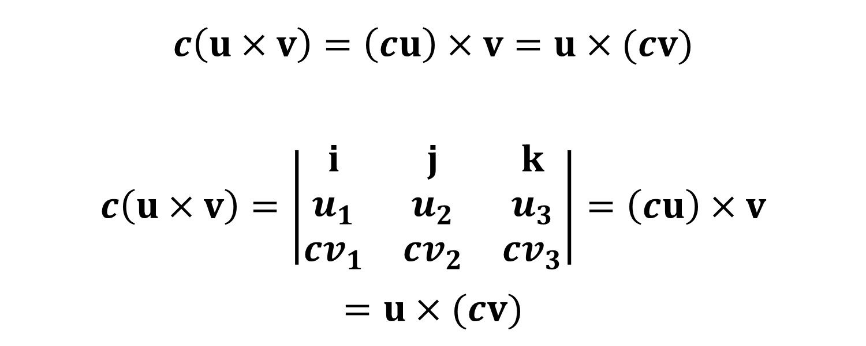
Proof (continued)
$$c\left(u×v\right)=\left(cu\right)×v=u×(cv)$$
$$c\left(u×v\right)=\left|\begin{matrix}i & j & k \\ u_{1} & u_{2} & u_{3} \\ {cv}_{1} & {cv}_{2} & cv_{3}\end{matrix}\right|=\left(cu\right)×v$$
$$=u×(cv)$$

Slide 19
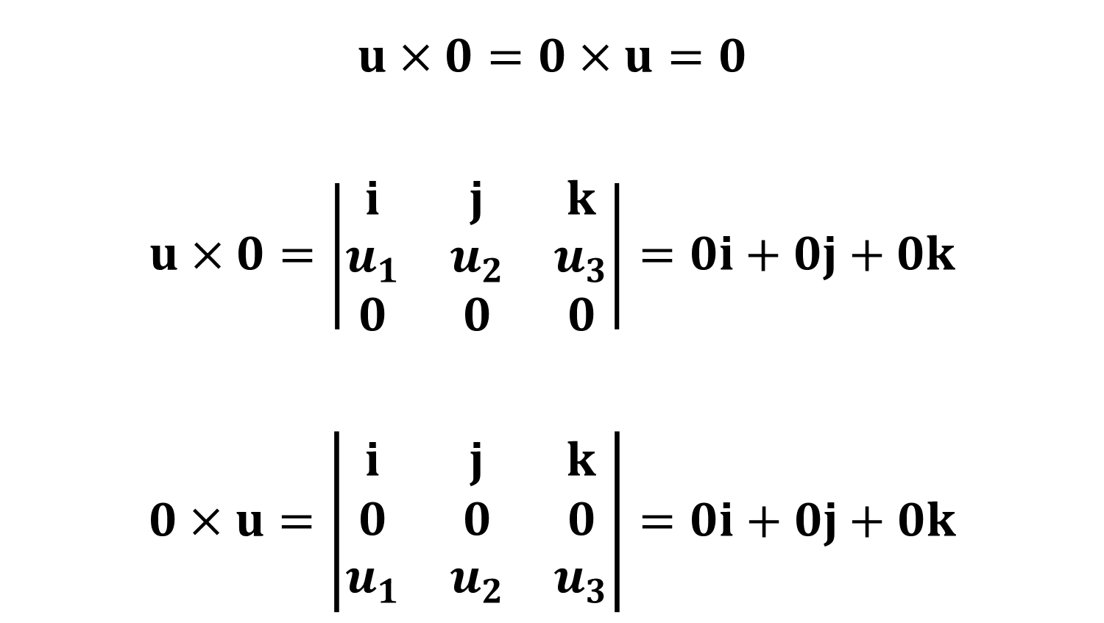
Proof (continued)
$$u×0=0×u=0$$
$$u×0=\left|\begin{matrix}i & j & k \\ u_{1} & u_{2} & u_{3} \\ 0 & 0 & 0\end{matrix}\right|=0i+0j+0k$$
$$0×u=\left|\begin{matrix}i & j & k \\ 0 & 0 & 0 \\ u_{1} & u_{2} & u_{3}\end{matrix}\right|=0i+0j+0k$$

Slide 20
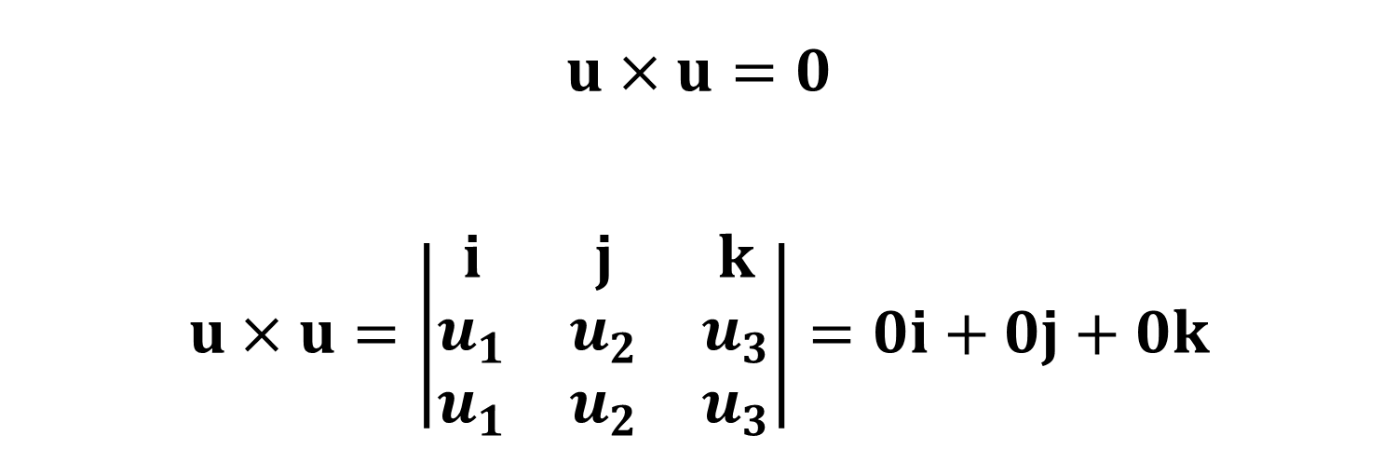
Proof (continued)
$$u×u=0$$
$$u×u=\left|\begin{matrix}i & j & k \\ u_{1} & u_{2} & u_{3} \\ u_{1} & u_{2} & u_{3}\end{matrix}\right|=0i+0j+0k$$

Slide 21
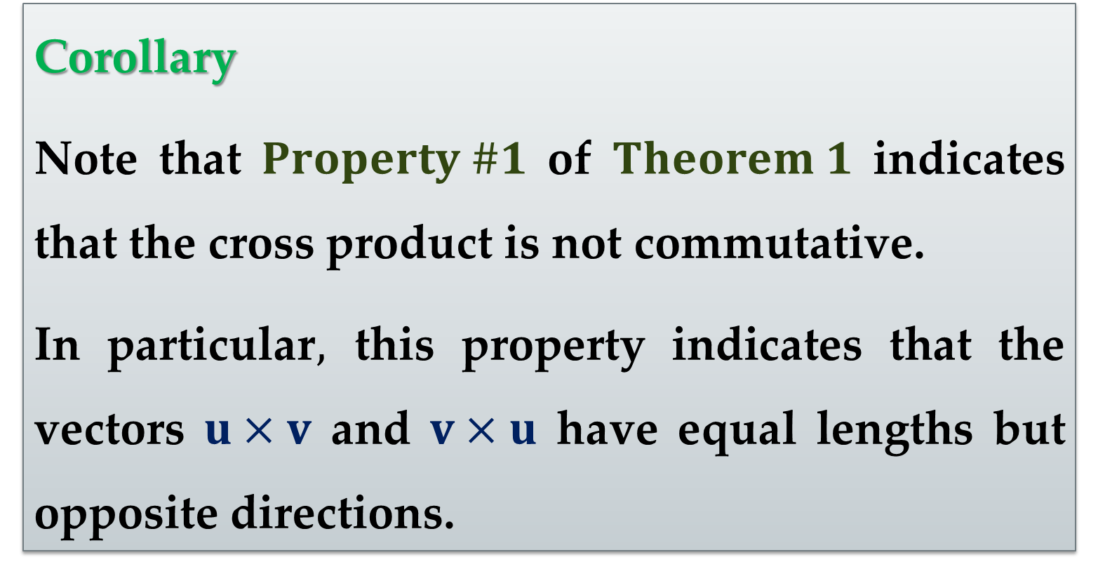
Corollary
Note that $Property \#1$ of $Theorem 1$ indicates that the cross product is not commutative.
In particular$,$ this property indicates that the vectors $u×v$ and $v×u$ have equal lengths but opposite directions.

Slide 22
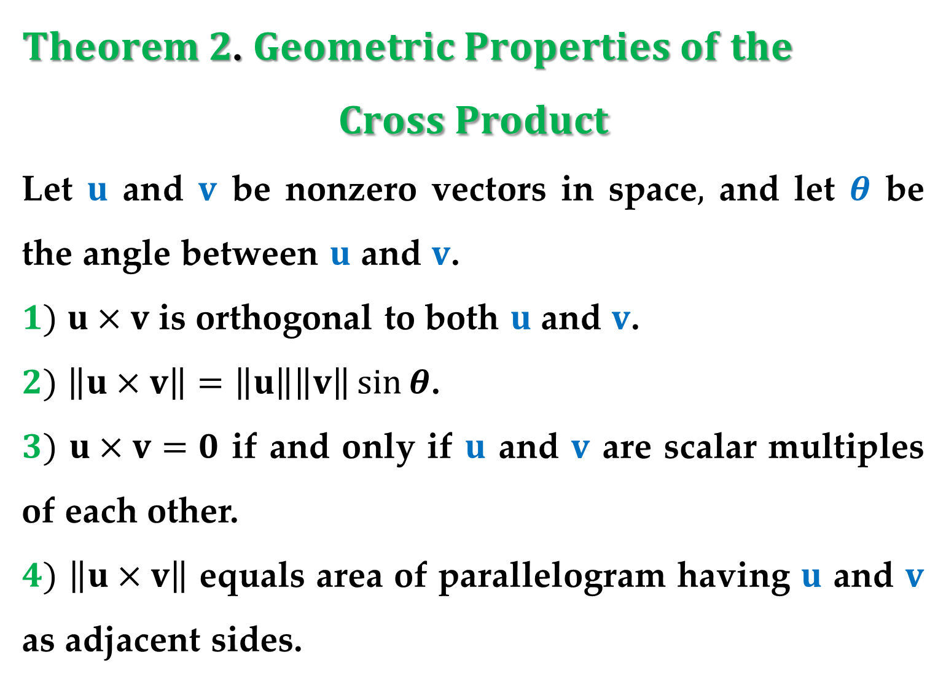
$Theorem 2$. $Geometric Properties of the$
$$Cross Product$$
Let $u$ and $v$ be nonzero vectors in space$,$ and let $θ$ be the angle between $u$ and $v$.
$1)$ $u×v$ is orthogonal to both $u$ and $v$.
$2)$ $\left\|u×v\right\|=\left\|u\right\|\left\|v\right\|\sin{θ}$.
$3)$ $u×v=0$ if and only if $u$ and $v$ are scalar multiples of each other.
$4)$ $\left\|u×v\right\|$ equals area of parallelogram having $u$ and $v$ as adjacent sides.

Slide 23
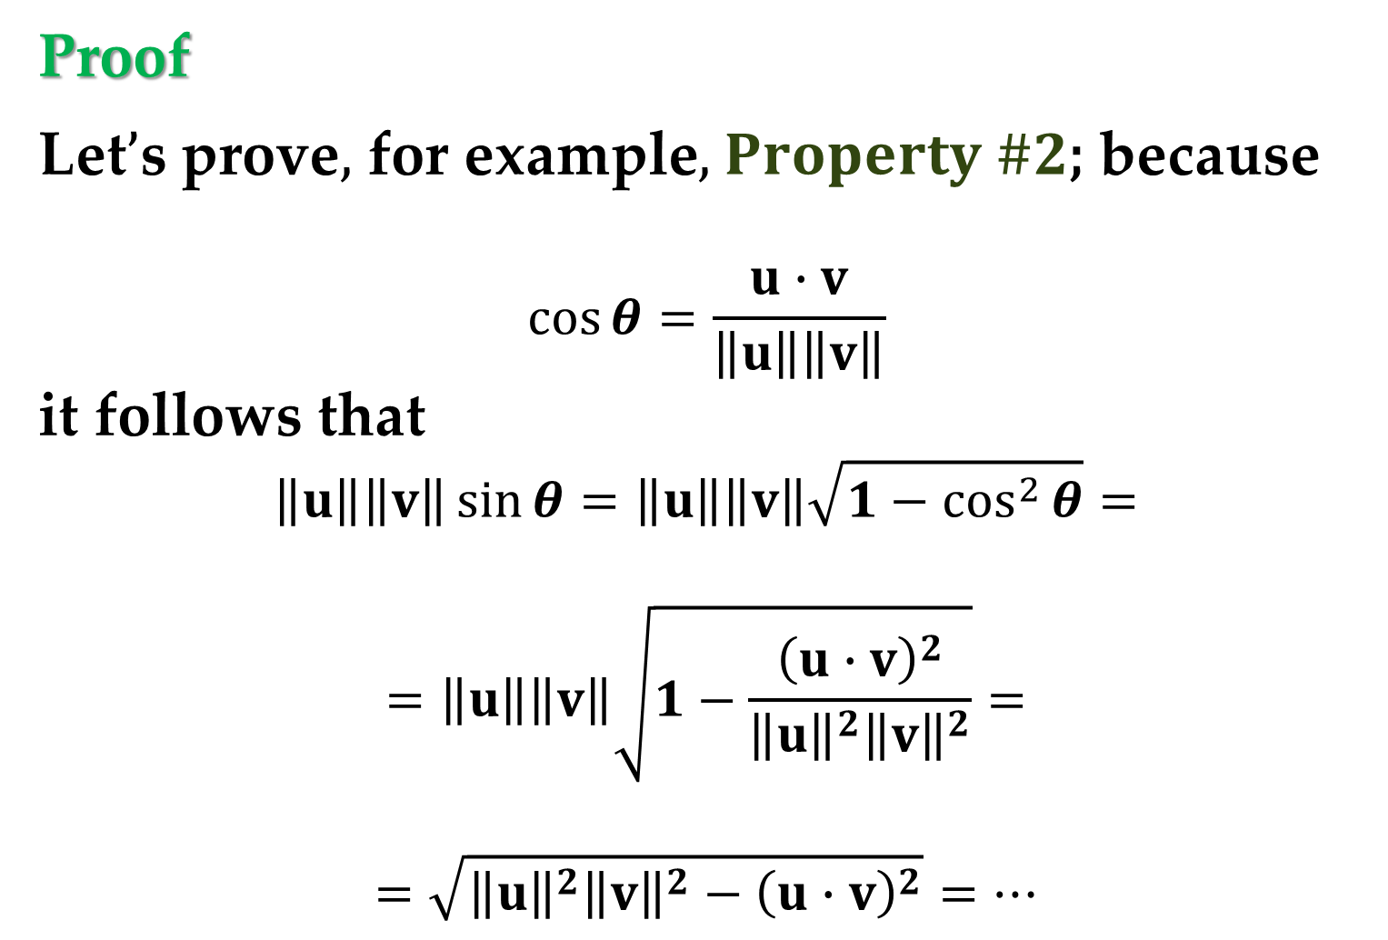
Proof
Let$’$s prove$,$ for example$,$ $Property \#2$; because
$$\cos{θ}=\frac{u∙v}{\left\|u\right\|\left\|v\right\|}$$
it follows that
$$\left\|u\right\|\left\|v\right\|\sin{θ}=\left\|u\right\|\left\|v\right\|\sqrt{1−\cos^{2}{θ}}=$$
$$=\left\|u\right\|\left\|v\right\|\sqrt{1−\frac{{\left(u∙v\right)}^{2}}{{\left\|u\right\|}^{2}{\left\|v\right\|}^{2}}}=$$
$$=\sqrt{{\left\|u\right\|}^{2}{\left\|v\right\|}^{2}−{\left(u∙v\right)}^{2}}=…$$

Slide 24
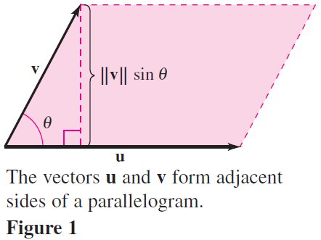
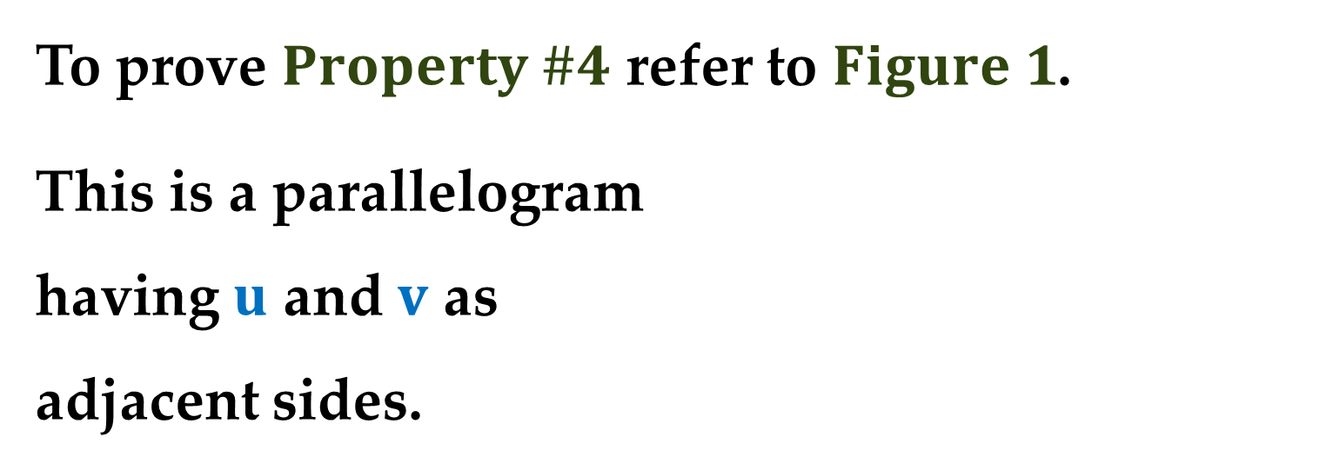
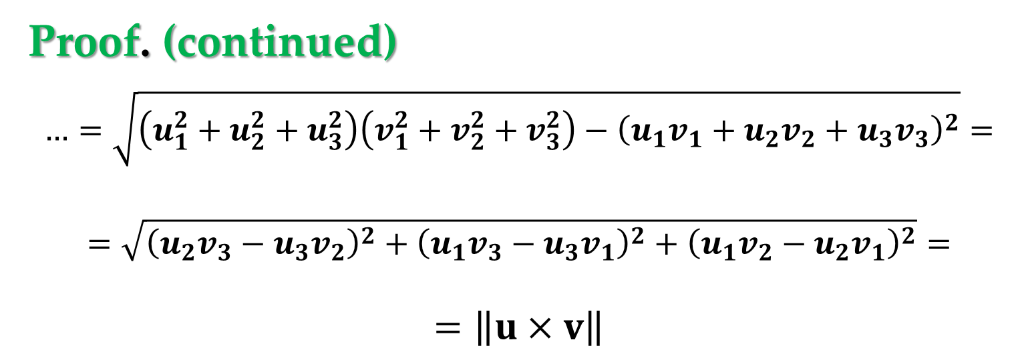
Proof. (continued)
$$…=\sqrt{\left(u_{1}^{2}+u_{2}^{2}+u_{3}^{2}\right)\left(v_{1}^{2}+v_{2}^{2}+v_{3}^{2}\right)−{\left(u_{1}v_{1}+u_{2}v_{2}+u_{3}v_{3}\right)}^{2}}=$$
$$=\sqrt{{\left(u_{2}v_{3}−u_{3}v_{2}\right)}^{2}+{\left(u_{1}v_{3}−u_{3}v_{1}\right)}^{2}+{\left(u_{1}v_{2}−u_{2}v_{1}\right)}^{2}}=$$
$$=\left\|u×v\right\|$$
To prove $Property \#4$ refer to $Figure 1$.
This is a parallelogram
having $u$ and $v$ as
adjacent sides.

Slide 25
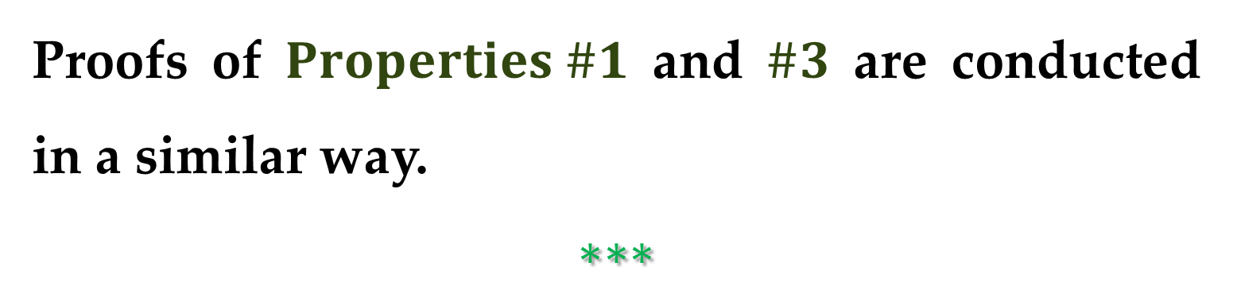
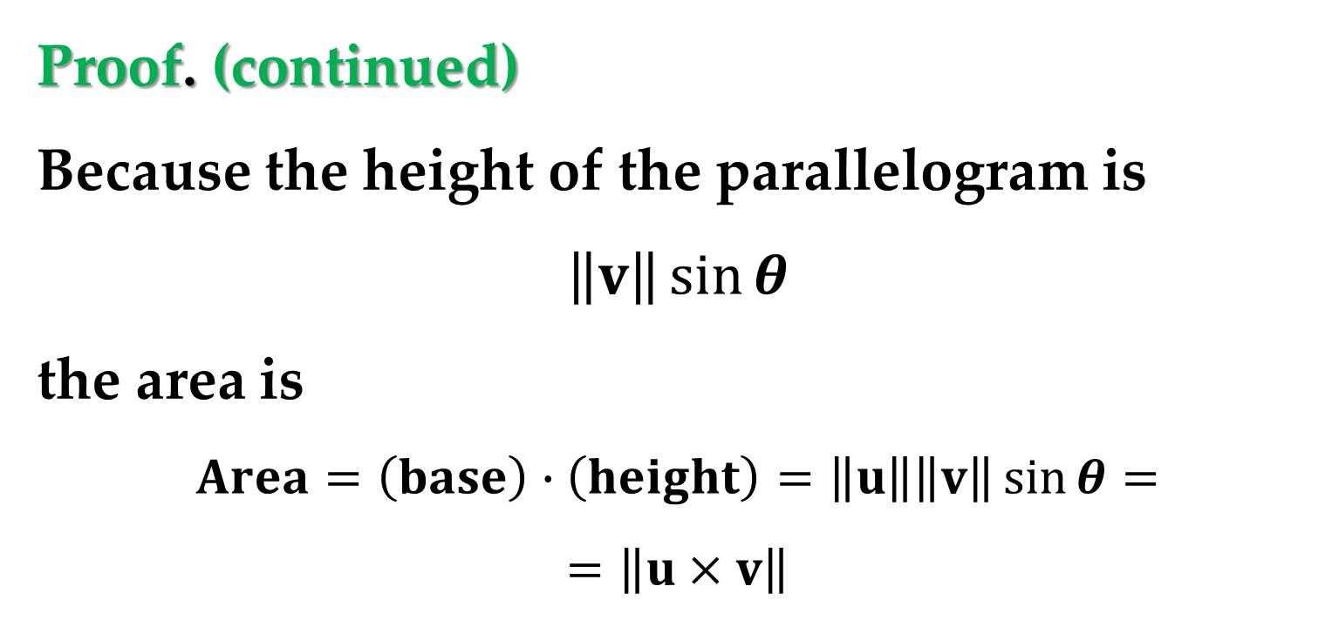
Proof. (continued)
Because the height of the parallelogram is
$$\left\|v\right\|\sin{θ}$$
the area is
$$Area=\left(base\right)∙\left(height\right)=\left\|u\right\|\left\|v\right\|\sin{θ}=$$
$$=\left\|u×v\right\|$$
Proofs of $Properties \#1$ and $\#3$ are conducted in a similar way.
$$∗∗∗$$

Slide 26
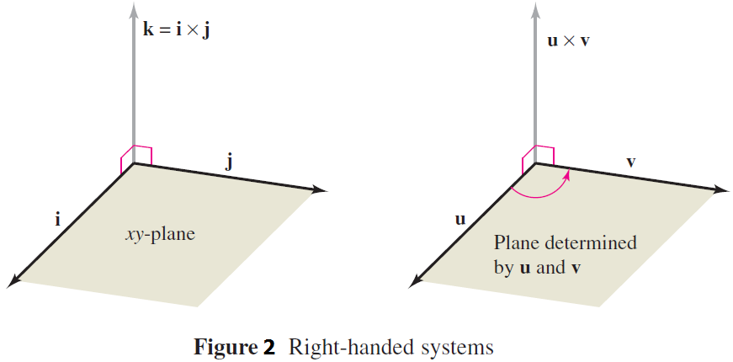
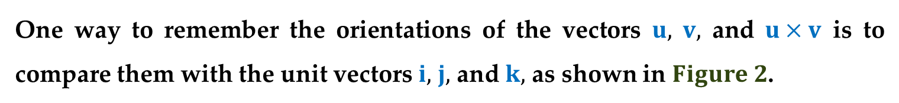
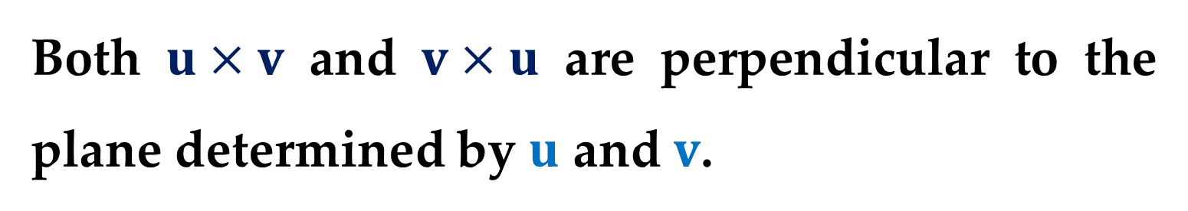
Both $u×v$ and $v×u$ are perpendicular to the plane determined by $u$ and $v$.
One way to remember the orientations of the vectors $u,$ $v,$ and $u×v$ is to compare them with the unit vectors $i,$ $j,$ and $k,$ as shown in $Figure 2$.

Slide 27
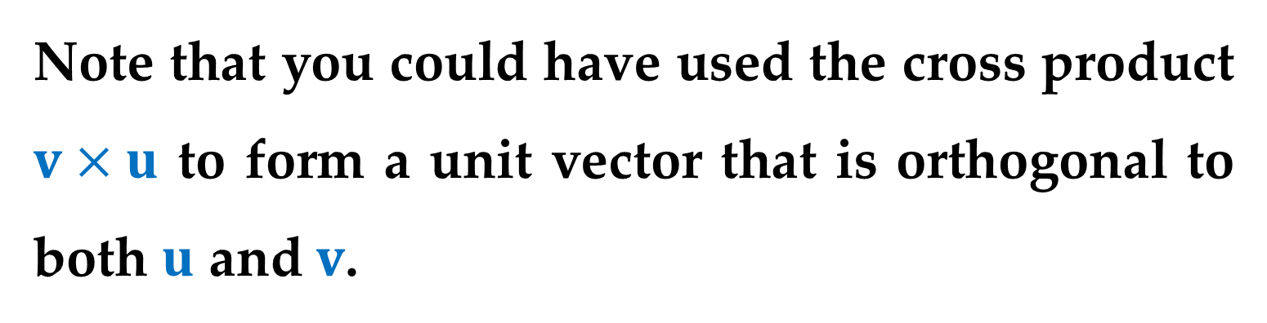
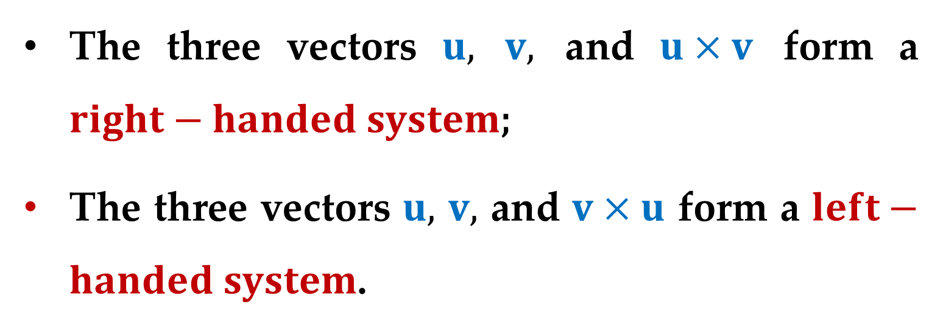
The three vectors $u,$ $v,$ and $u×v$ form a $right−handed system$;
The three vectors $u,$ $v,$ and $v×u$ form a $left−handed system$.
Note that you could have used the cross product $v×u$ to form a unit vector that is orthogonal to both $u$ and $v$.

Slide 28
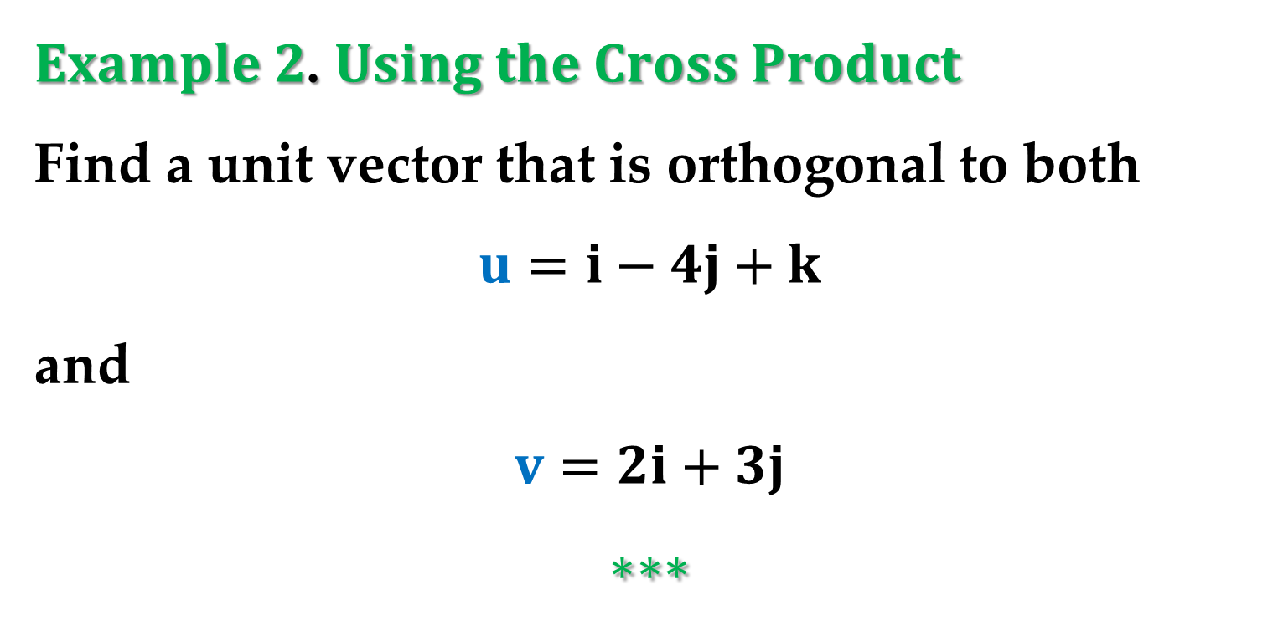
$Example 2$. $Using the Cross Product$
Find a unit vector that is orthogonal to both
$$u=i−4j+k$$
and
$$v=2i+3j$$
$$∗∗∗$$

Slide 29
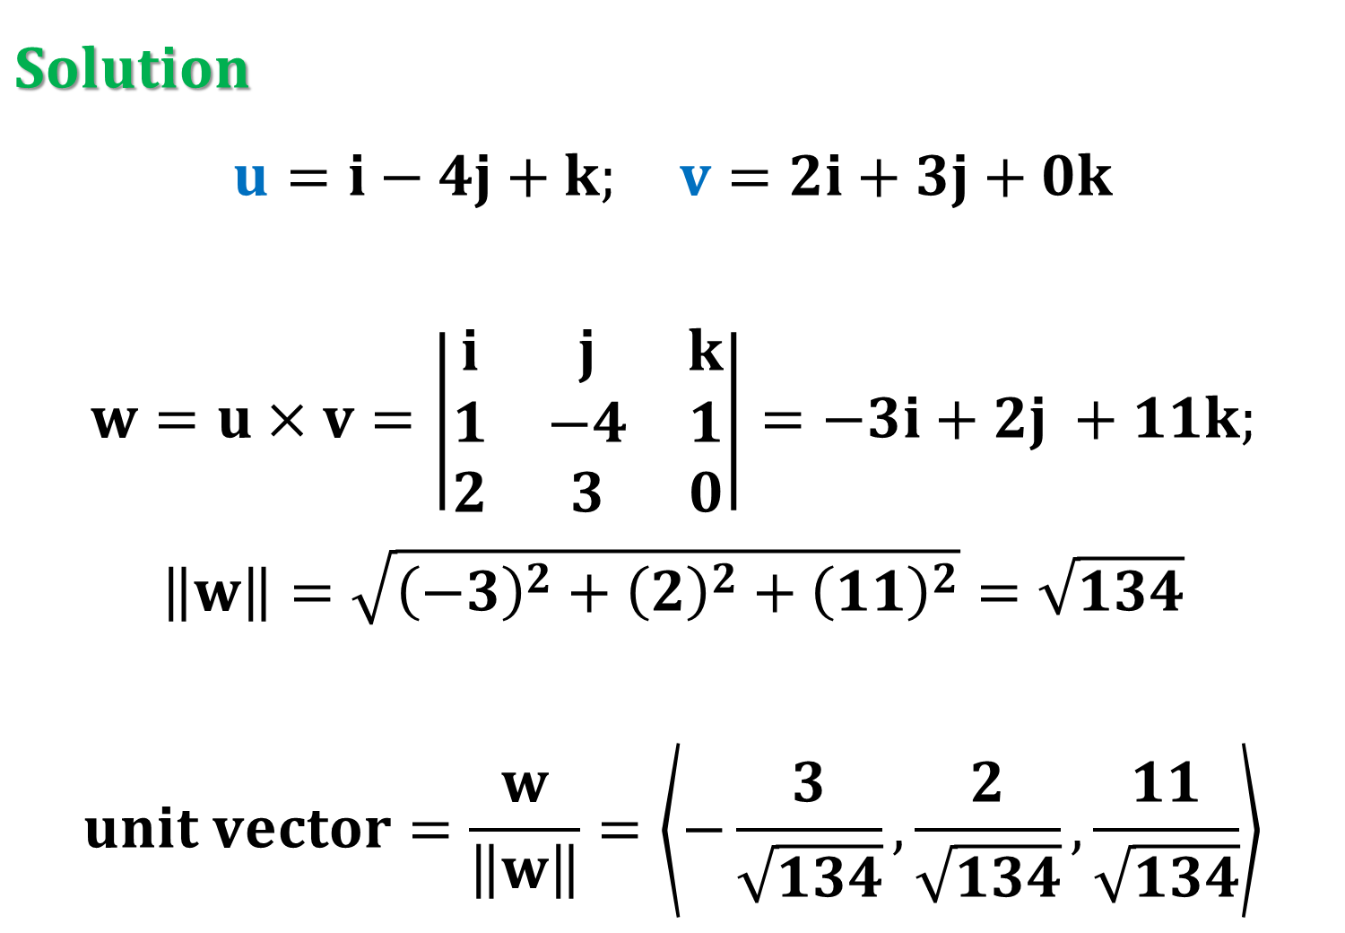
$Solution$
$$u=i−4j+k; v=2i+3j+0k$$
$$w=u×v=\left|\begin{matrix}i & j & k \\ 1 & −4 & 1 \\ 2 & 3 & 0\end{matrix}\right|=−3i+2j +11k;$$
$$\left\|w\right\|=\sqrt{{\left(−3\right)}^{2}+{\left(2\right)}^{2}+{\left(11\right)}^{2}}=\sqrt{134}$$
$$unit vector=\frac{w}{\left\|w\right\|}=\left\langle −\frac{3}{\sqrt{134}},\frac{2}{\sqrt{134}},\frac{11}{\sqrt{134}}\right\rangle$$

Slide 30
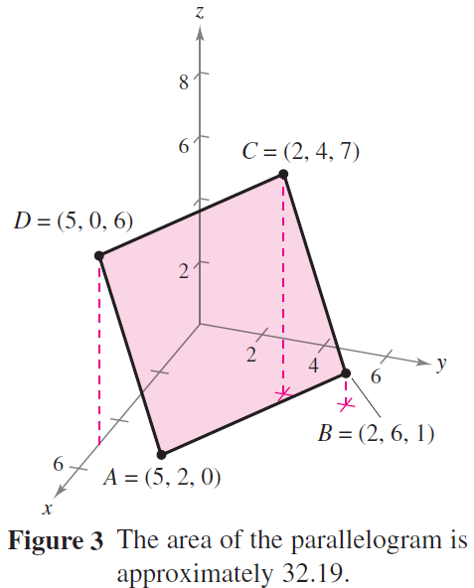
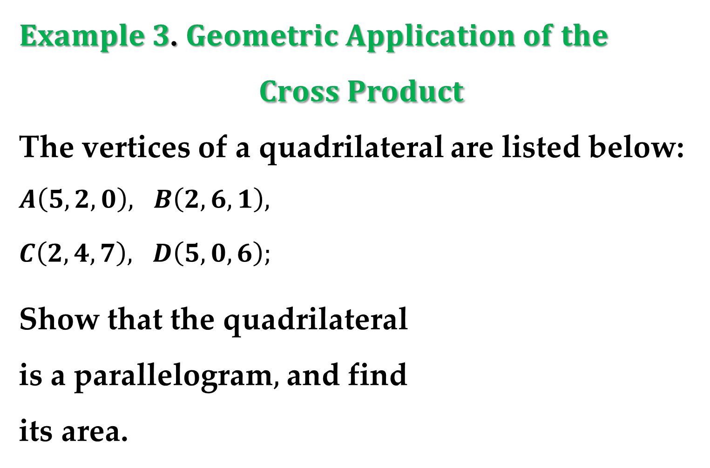
$Example 3$. $Geometric Application of the$
$$Cross Product$$
The vertices of a quadrilateral are listed below:
$A\left(5,2,0\right), B\left(2,6,1\right),$
$C\left(2,4,7\right), D\left(5,0,6\right);$
Show that the quadrilateral
is a parallelogram$,$ and find
its area.

Slide 31
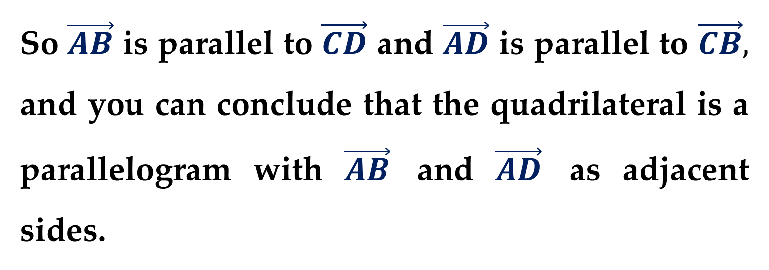
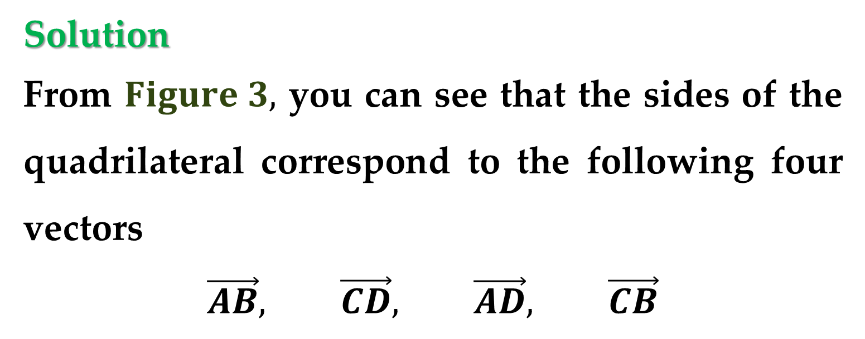
Solution
From $Figure 3,$ you can see that the sides of the quadrilateral correspond to the following four vectors
$$\vec{AB}, \vec{CD}, \vec{AD}, \vec{CB}$$
So $\vec{AB}$ is parallel to $\vec{CD}$ and $\vec{AD}$ is parallel to $\vec{CB},$ and you can conclude that the quadrilateral is a parallelogram with $\vec{AB}$ and $\vec{AD}$ as adjacent sides.

Slide 32
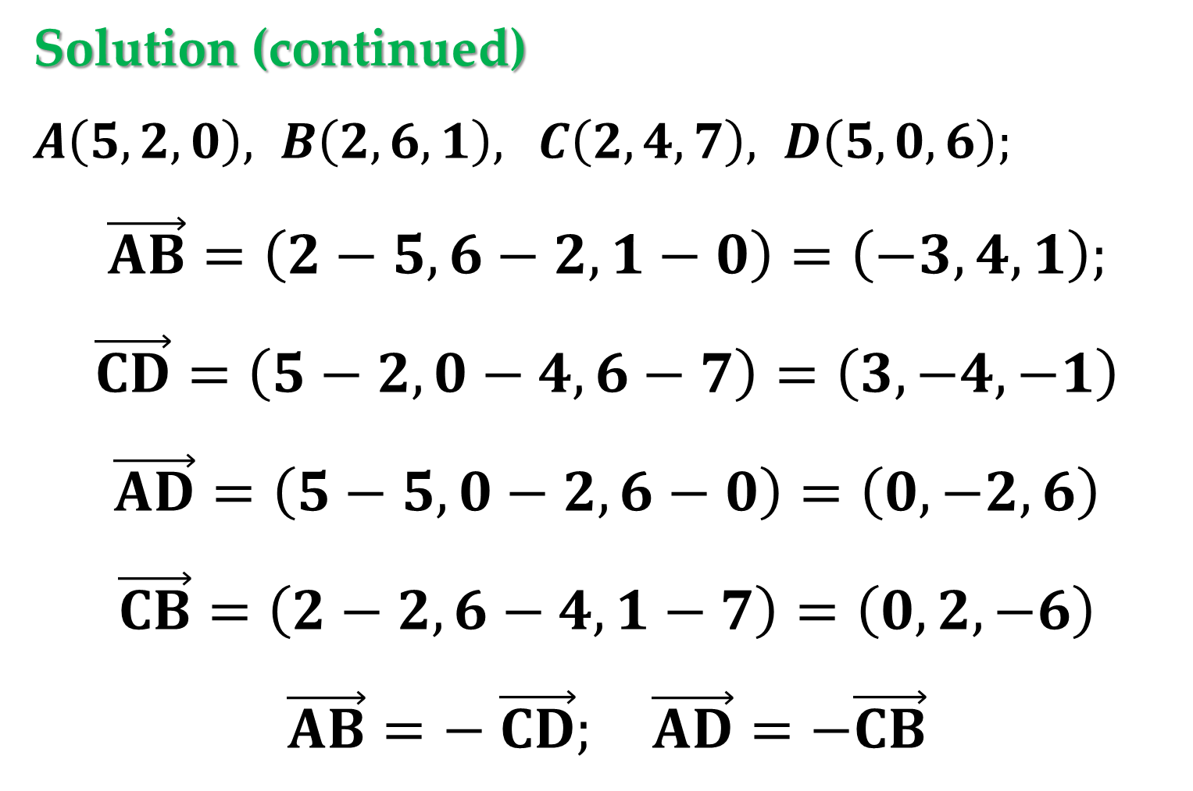
Solution (continued)
$A\left(5,2,0\right), B\left(2,6,1\right),$ $C\left(2,4,7\right), D\left(5,0,6\right);$
$$\vec{AB}=\left(2−5,6−2,1−0\right)=\left(−3,4,1\right);$$
$$\vec{CD}=\left(5−2,0−4,6−7\right)=\left(3,−4,−1\right)$$
$$\vec{AD}=\left(5−5,0−2,6−0\right)=\left(0,−2,6\right)$$
$$\vec{CB}=\left(2−2,6−4,1−7\right)=\left(0,2,−6\right)$$
$$\vec{AB}=− \vec{CD}; \vec{AD}=−\vec{CB}$$

Slide 33
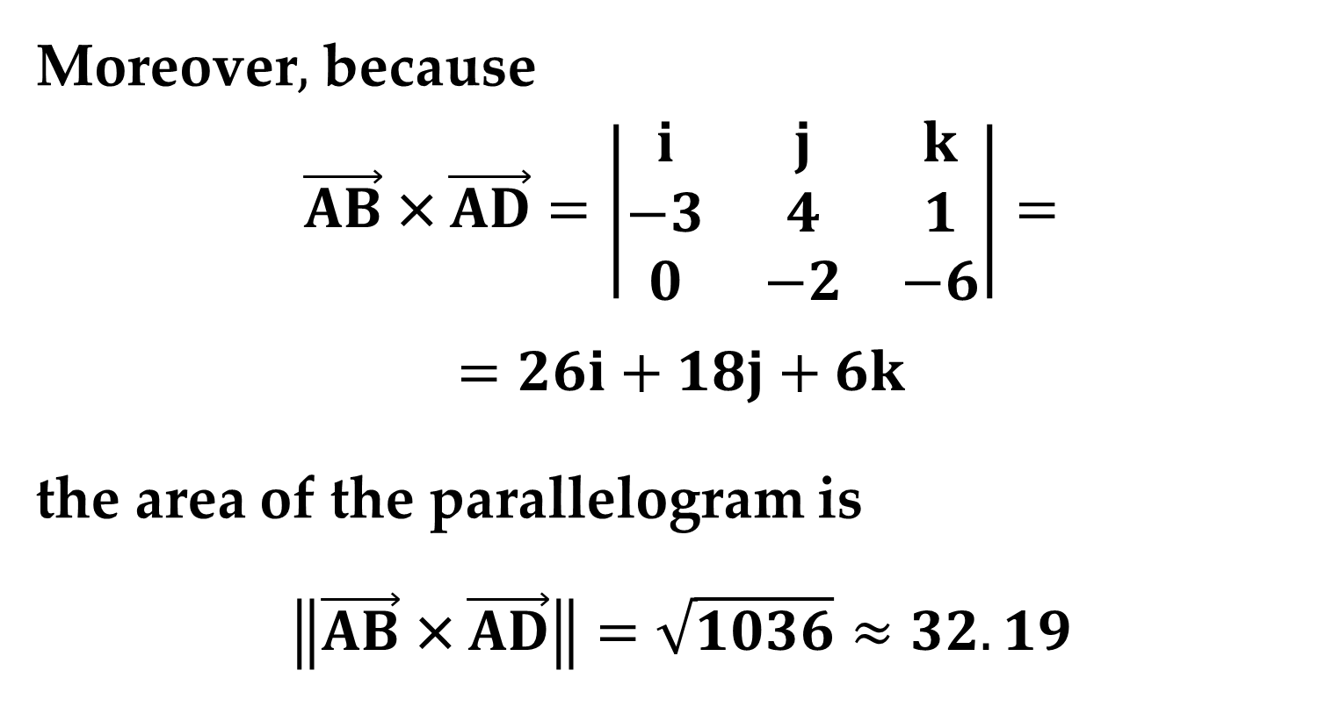
Solution (continued)
Moreover$,$ because
$$\vec{AB} \text{×} \vec{AD}=\left|\begin{matrix}i & j & k \\ −3 & 4 & 1 \\ 0 & −2 & −6\end{matrix}\right|=$$
$$=26i+18j+6k$$
the area of the parallelogram is
$$\left\|\vec{AB} \text{×} \vec{AD}\right\|=\sqrt{1036}≈32.19$$

Slide 34
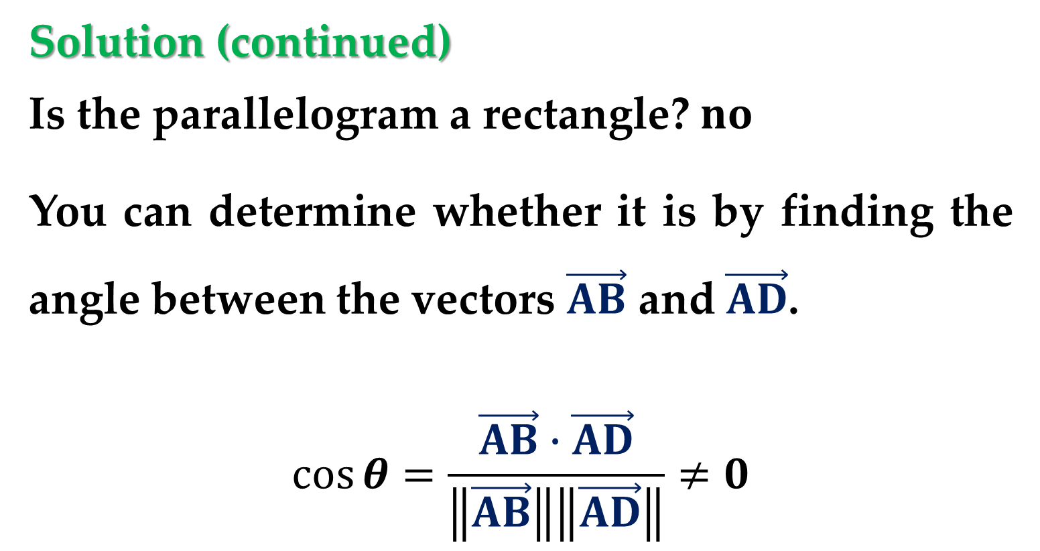
Solution (continued)
Is the parallelogram a rectangle? $no$
You can determine whether it is by finding the angle between the vectors $\vec{AB}$ and $\vec{AD}$.
$$\cos{θ}=\frac{\vec{AB}∙\vec{AD}}{\left\|\vec{AB}\right\|\left\|\vec{AD}\right\|}≠0$$

Slide 35
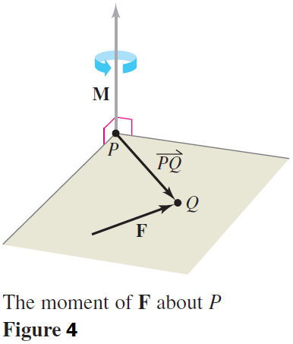
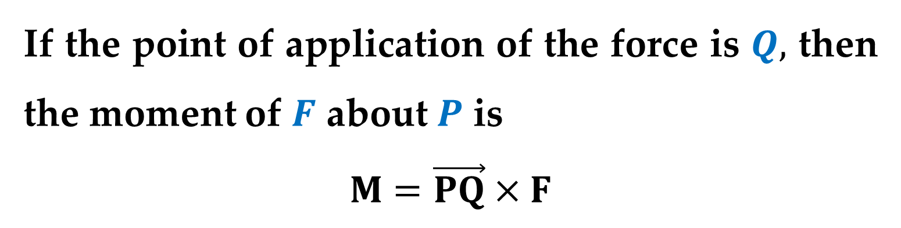
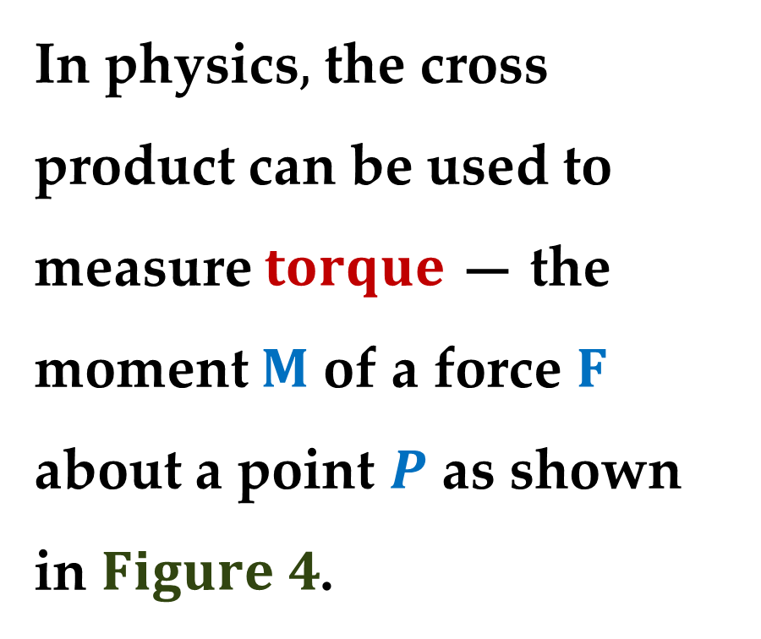
In physics$,$ the cross product can be used to measure $torque$ — the moment $M$ of a force $F$ about a point $P$ as shown
in $Figure 4$.
If the point of application of the force is $Q,$ then the moment of $F$ about $P$ is
$$M=\vec{PQ}×F$$

Slide 36
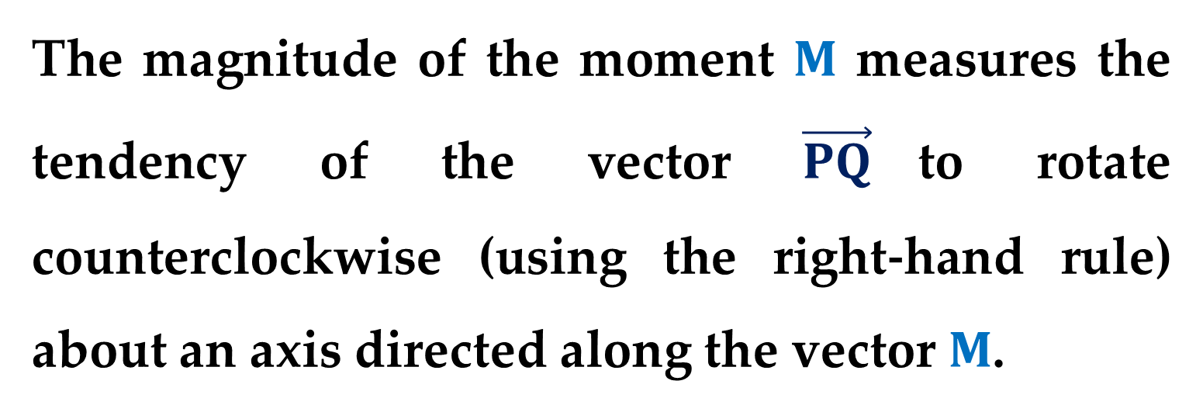
The magnitude of the moment $M$ measures the tendency of the vector $\vec{PQ}$to rotate counterclockwise (using the right-hand rule) about an axis directed along the vector $M$.

Slide 37



$Example 4$. An Application of the Cross Product
A vertical force of $50$ pounds is applied to the end of a one-foot lever that is attached to an axle at point $P$
(see $Figure 5$).
Find the moment of this force about the point $P$ when $θ=60^{o}$.

Slide 38

Solution
Represent the $50−$pound force as
$$F=−50k$$
and the lever as
$$\vec{PQ}=\cos{60^{o}}j+\sin{60^{o}}k=$$
$$=\frac{1}{2}j+\frac{\sqrt{3}}{2}k$$

Slide 39

Solution (continued)
The moment of $F$ about $P$ is
$$M=\vec{PQ}×F=\left|\begin{matrix}i & j & k \\ 0 & \frac{1}{2} & \frac{\sqrt{3}}{2} \\ 0 & 0 & −50\end{matrix}\right|=−25i$$
The magnitude of this moment is $25$ foot-pounds.

Slide 40


Solution (continued)
In $Example 4,$ note that the moment (the tendency of the lever to rotate about its axle) is dependent on the angle $θ$:
when $θ=\frac{π}{2},$ the moment is $0$.
the moment is greatest when $θ=0$.

Slide 41
The Triple Scalar Product

Slide 42

For vectors $u,$ $v,$ and $w$ in space$,$ the dot product of $u$ and $v×w$
$$u∙\left(v×w \right)$$
is called the $triple scalar product$.

Slide 43

$Theorem 3$. $The Triple Scalar Product$
For
$$u=u_{1}i+u_{2}j+u_{3}k, v=v_{1}i+v_{2}j+v_{3}k$$
$$w=w_{1}i+w_{2}j+w_{3}k$$
the triple scalar product is
$$u∙\left(v×w\right)=\left|\begin{matrix}u_{1} & u_{2} & u_{3} \\ v_{1} & v_{2} & v_{3} \\ w_{1} & w_{2} & w_{3}\end{matrix}\right|$$

Slide 44


Note that the value of a determinant is multiplied by $−1$ when any two rows are interchanged.
After two such interchanges$,$ the value of the determinant will be unchanged.
So the following triple scalar products are equivalent:
$$u∙\left(v×w \right)=v∙\left(w×u \right)=w∙\left(u×v\right)$$

Slide 45



If the vectors $u,$ $v,$ and $w$ do not lie in the same
plane$,$ then the triple scalar product $u∙\left(v×w\right)$ can be used to determine the volume of the parallelepiped (a polyhedron$,$ all of whose faces
are parallelograms) with $u,$ $v,$ and $w$ as adjacent edges, as shown in $Figure 6$.

Slide 46

$Theorem 4$. $Geometric Property of the$
$$Triple Scalar Product$$
The volume $V$ of a parallelepiped with vectors $u,$ $v,$ and $w$ as adjacent edges is
$$V=\left|u∙\left(v×w\right)\right|$$

Slide 47


Proof
In Figure $6,$ note that the area of the base is
$$area of base=\left\|v×w\right\|$$
and the height of the parallelepiped is
$$\text{height}=\left\|proj_{v×w}u\right\|$$
Therefore$,$ the volume is
$$V=\left(height\right)\left(area of base\right)=\left\|proj_{v×w}u\right\| \left\|v×w\right\|=$$
$$=\left|\frac{u∙\left(v×w\right)}{\left\|v×w\right\|}\right|\left\|v×w\right\|=\left|u∙\left(v×w\right)\right|$$

Slide 48


$Example 5$. Volume by the Triple Scalar Product
Find the volume of the parallelepiped having
$$u=3i−5j+k, v=2j−2k,$$
$$w=3i+j+k$$
as its adjacent sides.
$∗∗∗$

Slide 49


A natural consequence of $Theorem 4$ is that the volume of the parallelepiped is $0$ if and only if the three vectors are coplanar.
That is$,$ when the vectors
$$u=\left(u_{1},u_{2},u_{3}\right) v=\left(v_{1},v_{2},v_{3}\right)$$
$$w=\left(w_{1},w_{2},w_{3}\right)$$
have the same initial point$,$ they lie in the same plane if and only if
$$u∙\left(v×w\right)=0$$

Slide 50
Thank you for attention

Slide 51
text
text
text

